Slide 1
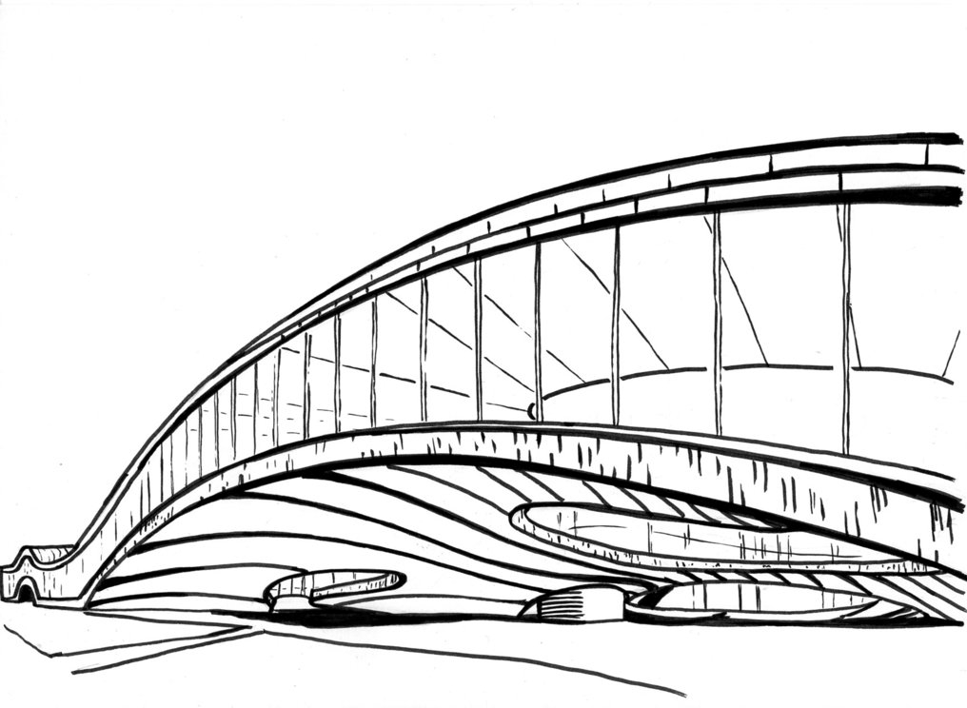
EPFL Logic Synthesis Libraries
Heinz Riener
heinz.riener@epfl.ch
¹EPFL, Lausanne, Switzerland
Logic Synthesis Software School (LSSS), 2019
Lausanne, Switzerland
https://github.com/lsils/lstools-showcase
★ Star and fork us on GitHub!

Slide 2
Outline
Overview [IWLS’18]
IWLS running example: exactmine
Generic Logic Synthesis with mockturtle [DAC’19]
Boolean rewriting using Exact Synthesis [DATE’19]

Slide 3
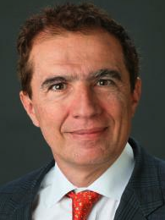
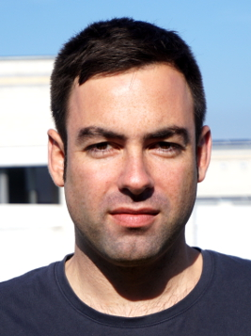
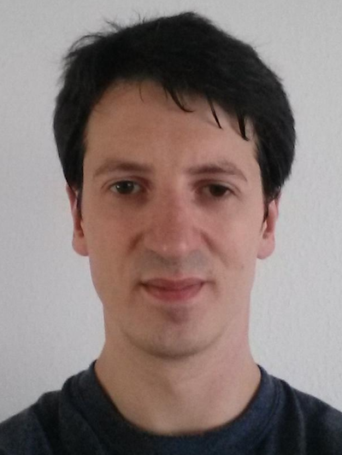
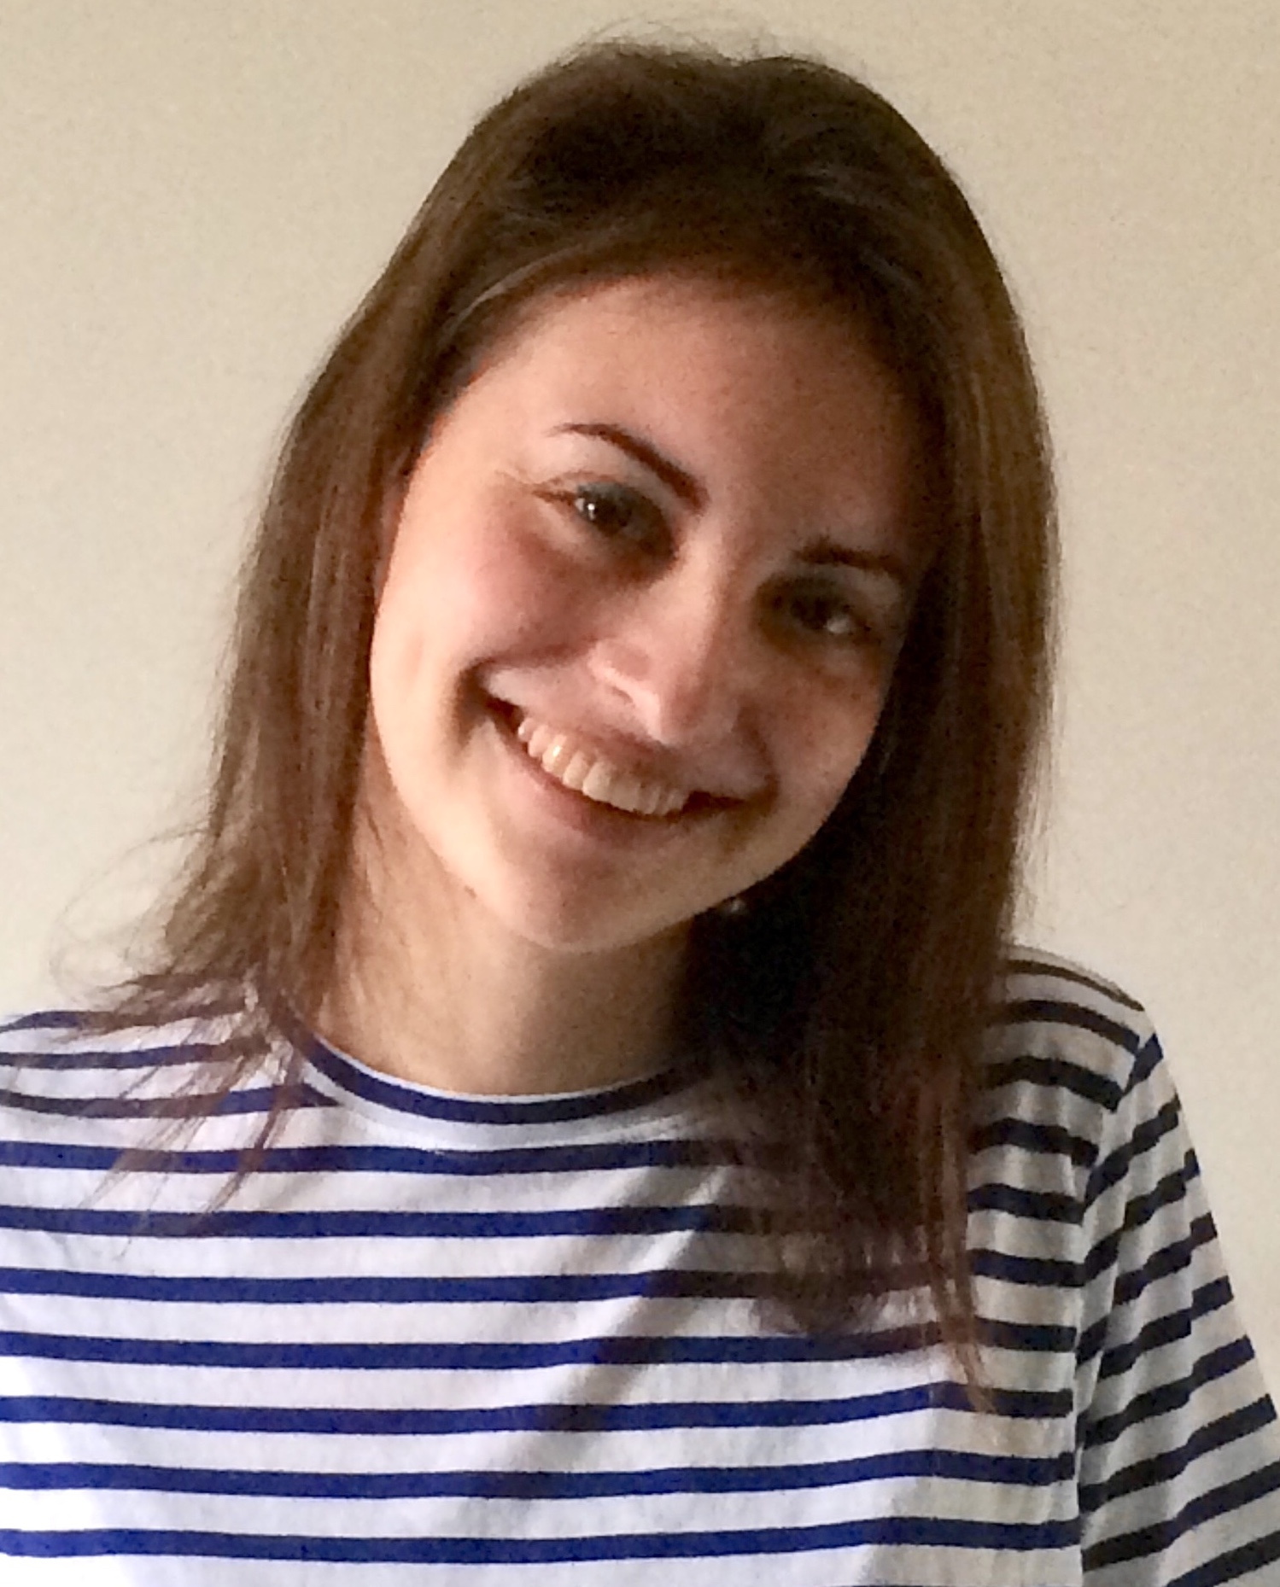
Team
Giovanni De Micheli
Mathias Soeken
Heinz Riener
Eleonora Testa
Winston Haaswijk
Giulia Meuli
Bruno Schmitt
Fereshte Mozafari

Slide 4
EPFL Logic Synthesis Libraries
Infrastructure for logic synthesis
Open source
Modular
Well-tested
Well-documented
Easy-to-integrate
percy:
exact synthesis lib.
mockturtle:
logic network lib.
lorina:
parsing lib.
alice:
command shell lib.
kitty:
truth table lib.
tweedledum:
quantum synth. lib.
easy:
ESOP lib.
caterpillar:
quantum comp. lib.
Mathias Soeken, Heinz Riener, Winston Haaswijk, and Giovanni De Micheli, The EPFL Logic Synthesis Libraries, Int’l Workshop on Logic Synthesis, arXiv:1805.05121, 2018.
URL: https://github.com/lsils/lstools-showcase

Slide 5
EPFL Logic Synthesis Libraries
Conventional logic synthesis
Infrastructure for logic synthesis
Open source
Modular
Well-tested
Well-documented
Easy-to-integrate
percy:
exact synthesis lib.
mockturtle:
logic network lib.
lorina:
parsing lib.
alice:
command shell lib.
kitty:
truth table lib.
tweedledum:
quantum synth. lib.
easy:
ESOP lib.
caterpillar:
quantum comp. lib.
Mathias Soeken, Heinz Riener, Winston Haaswijk, and Giovanni De Micheli, The EPFL Logic Synthesis Libraries, Int’l Workshop on Logic Synthesis, arXiv:1805.05121, 2018. URL: https://github.com/lsils/lstools-showcase

Slide 6
EPFL Logic Synthesis Libraries
Infrastructure for logic synthesis
Open source
Modular
Well-tested
Well-documented
Easy-to-integrate
percy:
exact synthesis lib.
mockturtle:
logic network lib.
lorina:
parsing lib.
alice:
command shell lib.
kitty:
truth table lib.
tweedledum:
quantum synth. lib.
easy:
ESOP lib.
caterpillar:
quantum comp. lib.
Quantum compilation
Mathias Soeken, Heinz Riener, Winston Haaswijk, and Giovanni De Micheli, The EPFL Logic Synthesis Libraries, Int’l Workshop on Logic Synthesis, arXiv:1805.05121, 2018. URL: https://github.com/lsils/lstools-showcase

Slide 7
EPFL Logic Synthesis Libraries
Conventional logic synthesis
Infrastructure for logic synthesis
Open source
Modular
Well-tested
Well-documented
Easy-to-integrate
percy:
exact synthesis lib.
mockturtle:
logic network lib.
lorina:
parsing lib.
alice:
command shell lib.
kitty:
truth table lib.
tweedledum:
quantum synth. lib.
easy:
ESOP lib.
caterpillar:
quantum comp. lib.
Quantum compilation
Mathias Soeken, Heinz Riener, Winston Haaswijk, and Giovanni De Micheli, The EPFL Logic Synthesis Libraries, Int’l Workshop on Logic Synthesis, arXiv:1805.05121, 2018.
URL: https://github.com/lsils/lstools-showcase

Slide 8
Motivation
Core libraries for dedicated logic synthesis tasks
Well-documented
Well-tested
Easy-to-integrate
State-of-the-art implementations
Reuse common functionality among several large projects
Open-source to allow everyone to use and contribute
Lessons learned from projects like Berkeley’s ABC
Research enabler for other projects
LSOracle
lgraph
fiction
Robber
z3
QuilC

Slide 9
Dissemination events
Upcoming events:
June, 2019: Presentation at the Logic Synthesis Software School in Lausanne, Switzerland.
Past events:
June, 2019: Presentation at the Week of Open Source Hardware in Zurich Switzerland.
June, 2019: Presentation at BoF Meeting: Open-Source Academic EDA Software Cont. in Las Vegas, NV, USA.
Feb., 2019: Presentation at FOSDEM CAD and Open Hardware devroom in Brussels, Belgium.
Nov., 2018: Presentation at the Workshop on Open-Source EDA Technology in San Diego, CA, USA.
Aug., 2018: Presentation at the IEEE CASS Seasonal School on Logic Synthesis in Porto Alegre, Brazil.
June, 2018: Presentation at the 27th International Workshop on Logic Synthesis in San Francisco, CA, USA.

Slide 10
EPFL Open Science Fund
Supported by EPFL’s Open Science Fund
Unfettered dissemination of scientific discourse
Open source
Open access
Open benchmarks
Reproduceable results
Reusable results

Slide 11
Implementation
Modern C++ (mainly C++14, some C++17)
Header-only
(Almost) no dependencies
Dependencies are header-only and shipped with library

Slide 12
IWLS running example
Simple shell interface
Load truth tables
Find optimum networks
Load from binary and hexadecimal string
Load from BENCH file
Use NPN canonization
268 lines of code
URL: https://github.com/lsils/lstools-showcase/tree/master/examples/exactmine

Slide 13
Command shell with alice
#include <alice/alice.hpp>
class optimum_network
{
// ...
public:
kitty::dynamic_truth_table function{0};
std::string network; };
namespace alice {
ALICE_ADD_STORE( optimum_network, “opt”, “o”, “network”, “networks” )
}
ALICE_MAIN( exactmine )

Slide 14
alice: C++ command shell library
General shell features: command completion, command history
Automatic logging for commands into JSON files
Custom properties
Makes it easy to parse log files (no more grep and awk)
Multiple store types and multiple store elements
ALICE_ADD_STORE( abc::Gia_Man_t*, “aig”, “a”, ”AIG”, “AIGs” )
ALICE_ADD_STORE( abc::Wlc_Ntk_t*, “wlc”, “w”,
“Word-level network”,
“Word-level networks” )

Slide 15
Easy Python and C bindings
Command interface can be compiled into Python library
No need to modify code, enabled by compile option
Python interface useful for integration to Jupyter notebooks
Similar for C library (and therefore .NET, JVM, Tcl, …)
abc2> read_verilog file.v
abc2> ps –-wlc
abc2> convert –wlc_to_aig
abc2> ps –-aig
import abc2
abc2.read_Verilog(filename=“file.v”)
abc2.ps(wlc=True)
abc2.convert(wlc_to_aig=True)
r = abc2.ps(aig=True)
nodes = r[“nodes”]

Slide 16
Showing store details
#include <kitty/kitty.hpp>
ALICE_PRINT_STORE( optimum, os, opt )
{
os << fmt::format( “function (hex): {}\nfunction (bin): {}\n”,
kitty::to_hex( opt.function ),
kitty::to_binary( opt.function ) );
if ( opt.network.empty() ) {
os << “no optimum network computed\n”;
}
else {
os << fmt::format( “optimum network: {}\n”, opt.network );
}
}
Implements “print” behavior
Similar methods for “ps”, “show”, “read_*”, “write_*”

Slide 17
Implementing custom commands
class load_command : public command {
public:
load_bench_command( environments::ptr& env ) : command( env, “Load new entry” ) {
add_option( “truth_table,--tt”, truth_table, “truth table in hex format” );
add_flag( “—-binary,-b”, “read truth table as binary string” );
}
void execute() override {
count unsigned num_vars = std::log2( truth_table.size() );
kitty::dynamic_truth_table function( num_vars );
kitty::create_from_binary_string( function, truth_table );
... }
auto validity_rules() const override { ... }
auto log() const override { ... }
private:
std::string truth_table;
};
ALICE_ADD_COMMAND( load, “Loading” );

Slide 18
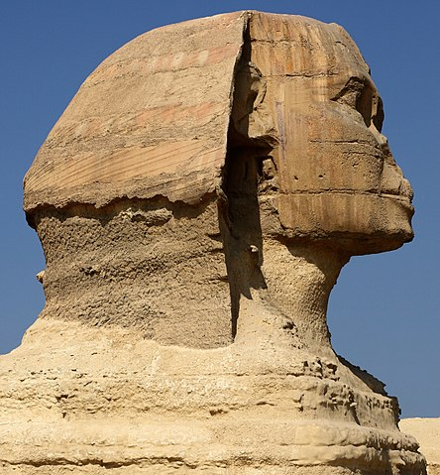
kitty: C++ truth table library
Two data structures: static and dynamic truth tables
Truth tables cannot change size after creation
static
#vars known at compile-time
Always saved on stack
dynamic
#vars known at run-time
May be saved on heap

Slide 19
Dynamic vs. static truth tables
kitty::static_truth_table<3> a, b, c;
kitty::create_nth_var( a, 0 );
kitty::create_nth_var( b, 1 );
kitty::create_nth_var( c, 2 );
auto f1 = a ^ b ^ c;
auto f2 = kitty::ternary_majority( a, b, c );
kitty::dynamic_truth_table a( 3 ), b( 3 ), c( 3 );
kitty::create_nth_var( a, 0 );
kitty::create_nth_var( b, 1 );
kitty::create_nth_var( c, 2 );
auto f1 = a ^ b ^ c;
auto f2 = kitty::ternary_majority( a, b, c );

Slide 21
NPN Canonization
kitty::dynamic_truth_table f( 6 );
kitty::create_random( f );
auto npn = kitty::exact_npn_canonization( f );
std::cout << “Repr.: ” << kitty::to_hex( std::get<0>( npn ) ) << “\n”;
kitty::dynamic_truth_table f2 = f.construct();
kitty::create_from_npn_config( f2, npn );
assert( f == f2 );

Slide 22
Create from chains
In: J. Boyar, R. Peralta: A small depth-16 circuit for the AES S-Box, SEC 2012
std::vector<std::string> chain{
“x5 = x3 ^ x4”, “x6 = x1 & x3”, “x7 = x2 ^ x6”, ”x8 = x1 ^ x2”,
“x9 = x4 ^ x6”, “x10 = x8 ^ x9”, “x11 = x5 & x7”, “x12 = x1 & x4”,
“x13 = x8 & x12”, “x14 = x8 ^ x13”, “x15 = x2 & x3”,
“x16 = x5 & x15”, ”x17 = x5 ^ x16”, ”x18 = x6 ^ x17”,
“x19 = x4 ^ x11”, “x20 = x6 ^ x14”, “x21 = x2 ^ x10” };
std::vector<kitty::static_truth_table<4>> steps;
kitty::create_multiple_from_chain( 4, steps, chain );
std::vector<static_truth_table<4>> y{
steps[17], steps[18], step[19], steps[20] };

Slide 23
Read truth tables from LUTs
#include <lorina/lorina.hpp>
class load_bench_command : public command {
public:
load_bench_command( const environment::ptr& env )
: command( env, “Load entries from LUT functions in BENCH file” ) {
add_option( “filename,--filename” ), filename, “BENCH filename” )->check( ExistingFileWordExp );
add_option( “—threshold,-t”, threshold,
”skip functions with more than this number of inputs”, 4u ); }
class lut_parser { ... };
void execute() override {
lorina::read_bench( filename, lut_parser( *this ) ); }
private:
std::string filename;
unsigned threshold = 6u;
};

Slide 24
lorina: C++ parsing library
class lut_parser : public lorina::bench_reader {
public:
void on_gate( const std::vector<std::string>& inputs,
const std::string& output,
const std::string& type ) const override {
const auto num_vars = inputs.size();
if ( num_vars > cmd.threshold ) return;
if ( !( type.size() > 2u && type[0] == ‘0’ && type[1] == ‘x’ ) ) {
cmd.env->out() << “[w] ignore gate ‘” << type << “’\n”;
return;
}
kitty::dynamic_truth_table function( num_vars );
kitty::create_from_hex_string( function, type.substr( 2u ) );
add_optimum_network_entry( cmd, function ); }
};

Slide 25
Features of lorina
Lightweight and customizable parsing library
Flexible and easy to use callback mechanisms
Parsers for Aiger, BENCH, BLIF, PLA, Verilog, …
Visitation of primitives in topological order
Diagnostic engine
class diagnostics : public diagnostic_engine
{
public:
void emit( diagnostic_level level, const std::string& message ) const override {
std::cerr << message << “\n”; }
};

Slide 26
Optimum networks with exact synthesis
#include <percy/percy.hpp>
class find_network_command : public command {
public:
void execute() override
{
auto& opt = store<optimum_network>().current();
percy::spec spec;
pec.verbosity = is_set( “verbose” ) ? 1 : 0;
spec[0] = opt.function;
percy::chain c;
if ( percy::synthesize( spec, c ) != percy::success ) { ... }
if ( is_set( “verify” ) ) {
if ( c.simulate( spec )[0] == opt.function ) { ... }
}
std::stringstream str;
c.to_expression( str );
opt.network = str.str(); } };

Slide 27
percy: C++ exact synthesis library
Choose between alternative encoders
Different and extensible SAT backends
DAG topology constraints
Parallel exact synthesis
Flexibility through composability
Synthesizer
Specification
>
Encoder
Solver
>
Chain

Slide 28
Flexibility through composability
/* specification object to describe what function to synthesize */
spec spec;
spec.set_nr_out( 2 );
/* result of synthesis is a Boolean chain (i.e., a multi-level logic network) */
chain c;
dynamic_truth_table x( 3 ), y( 3 ), z( 3 );
create_nth_var( x, 0 );
create_nth_var( y, 1 );
create_nth_var( z, 2 );
spec[0] = x ^ y ^ z;
spec[1] = ternary_majority( x, y, z );
/* call percy with specification */
auto const result = synthesize( spec, c );

Slide 29
Flexibility through composability
/* custom selection of solver, encoder, and synthesis method */
// SLV_BSAT2, SLV_CMSAT, SLV_GLUCOSE (also SYRUP), SLV_SATOKO
percy::SolverType solver_type = percy::SLV_BSAT2;
// ENC_SSV, ENC_MSV, ENC_DITT, ENC_FENCE, ENC_DAG
percy::EncoderType encoder_type = percy::ENC_SSV;
// SYNTH_STD, SYNTH_STD_CEGAR, SYNTH_FENCE, SYNTH_FENCE_CEGAR
percy::SynthMethod synth_method = percy::SYNTH_STD;
auto solver = get_solver( solver_type );
auto encoder = get_encoder( *solver, encoder_type );
auto const result = synthesize( spec, c, *solver, *encoder, synth_method );
if ( result == percy::synth_result::success )
{
std::cout << "# Synthesis successful" << std::endl;
c.print_dot();
}

Slide 30
EPFL Logic Synthesis Libraries: Summary
Extract well-understood and often used algorithms into separate small and dedicated libraries
Use documentation, testing, micro-benchmarking, continuous integration, and version control from the very beginning
Avoid dependencies (except for other small and lightweight libraries)
Open source to share with others!
https://github.com/lsils/lstools-showcase
★ Star and fork us on GitHub!

Slide 31
Generic Logic Synthesis
Logic synthesis deals with finding a logic circuits of a Boolean function wrt. a cost function (number of gates, depth of the circuit)
Algorithms use multi-level logic representations
Good trade-off between quality and performance
Examples:
AIGs: AND nodes + complementary edges [TCAD02]
MIGs: MAJ3-nodes + complementary edges [DAC14]
XAGs: AIG + XOR gates [DDECS17]
XMGs: MIG + XOR gates [ASPDAC17]
Others logic representations

Slide 32
Multi-level logic representations
Example: ${prime}_{5}\left(x_{1},…,x_{5}\right)=[{\left(x_{5}…x_{1}\right)}_{2} is prime]$

Slide 33
Multi-level logic representations
Example: ${prime}_{5}\left(x_{1},…,x_{5}\right)=[{\left(x_{5}…x_{1}\right)}_{2} is prime]$
16
17
18
19
20
21
22
23
24
25
26
27
28
29
30
31
0
1
2
3
4
5
6
7
8
9
10
11
12
13
14
15

Slide 34
Multi-level logic representations
Example: ${prime}_{5}\left(x_{1},…,x_{5}\right)=[{\left(x_{5}…x_{1}\right)}_{2} is prime]$
16
17
18
19
20
21
22
23
24
25
26
27
28
29
30
31
0
1
0
1
0
0
0
1
0
0
0
0
0
1
0
1
0
1
2
3
4
5
6
7
8
9
10
11
12
13
14
15
0
0
1
1
0
1
0
1
0
0
0
1
0
1
0
0

Slide 35
Multi-level logic representations
Example: ${prime}_{5}\left(x_{1},…,x_{5}\right)=[{\left(x_{5}…x_{1}\right)}_{2} is prime]$
16
17
18
19
20
21
22
23
24
25
26
27
28
29
30
31
0
1
0
1
0
0
0
1
0
0
0
0
0
1
0
1
0
1
2
3
4
5
6
7
8
9
10
11
12
13
14
15
0
0
1
1
0
1
0
1
0
0
0
1
0
1
0
0
a08a
28ac

Slide 36
Multi-level logic representations
Example: ${prime}_{5}\left(x_{1},…,x_{5}\right)=[{\left(x_{5}…x_{1}\right)}_{2} is prime]$
16
17
18
19
20
21
22
23
24
25
26
27
28
29
30
31
0
1
0
1
0
0
0
1
0
0
0
0
0
1
0
1
0
1
2
3
4
5
6
7
8
9
10
11
12
13
14
15
0
0
1
1
0
1
0
1
0
0
0
1
0
1
0
0
Given: a Boolean function
Employ SAT-based Exact Synthesis to find optimum circuit repr. as AIG/MIG
ABC: exact -C 0 -a a08a28ac
CirKit2: tt 0xa08a28ac; exact -m
a08a
28ac

Slide 37
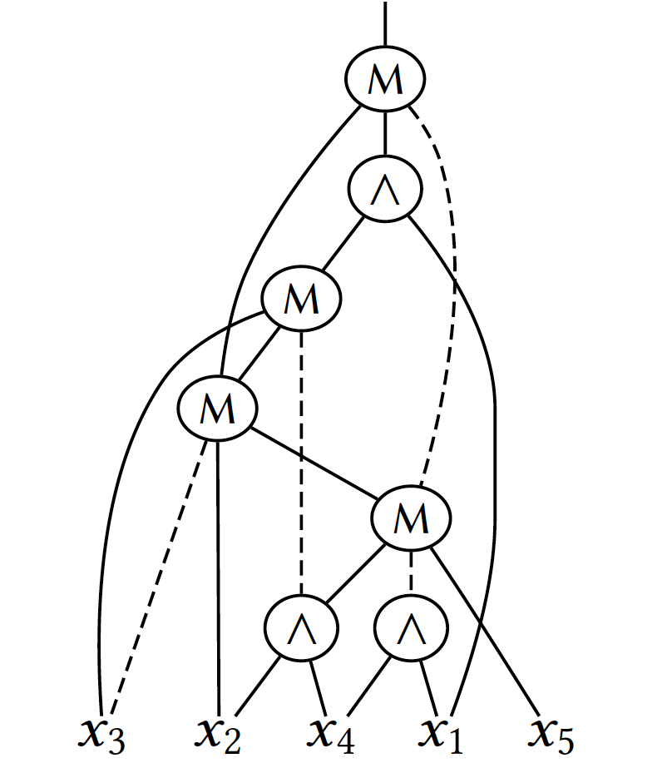
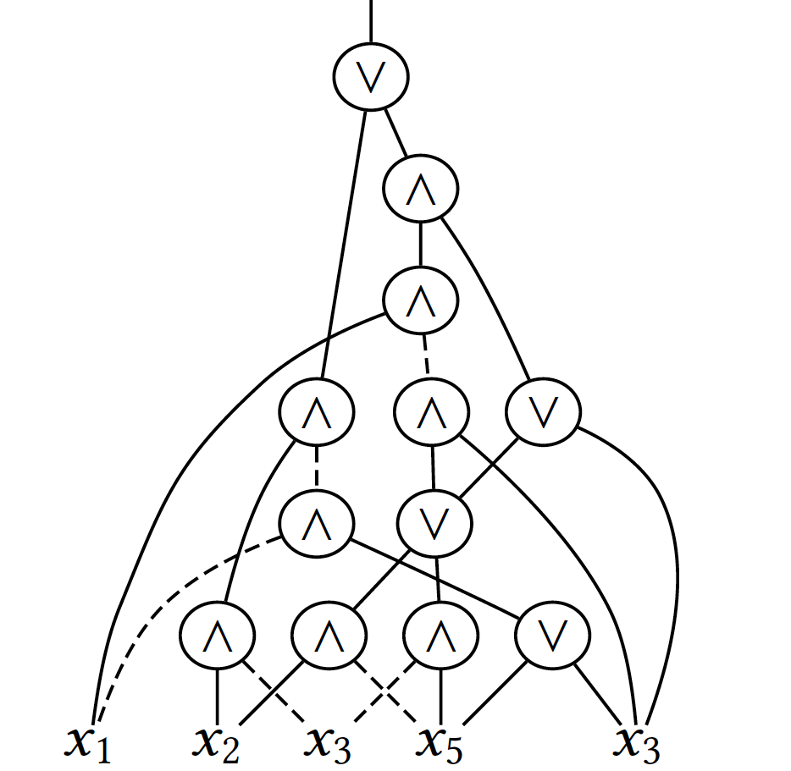
Multi-level logic representations
Example: ${prime}_{5}\left(x_{1},…,x_{5}\right)=[{\left(x_{5}…x_{1}\right)}_{2} is prime]$
MIG: 7x MAJ-3 nodes
AOIG: 8x AND nodes 4x OR nodes
CirKit2: tt 0xa08a28ac; exact -m
ABC: exact -C 0 -a a08a28ac

Slide 38
Majority logic
Majority-of-three (MAJ-3) function:
$$⟨x_{1}x_{2}x_{3}⟩$$
MAJ-3
$$x_{1}$$
$$x_{2}$$
$$x_{3}$$

Slide 39
Majority logic
Majority-of-three (MAJ-3) function:
1
$$⟨x_{1}x_{2}x_{3}⟩$$
MAJ-3
$$x_{1}$$
$$x_{2}$$
$$x_{3}$$
1
0
1

Slide 40
Majority logic
Majority-of-three (MAJ-3) function:
$$x_{1}$$ | $$x_{2}$$ | $$x_{3}$$
0 | 0 | 0 | 0
0 | 0 | 1 | 0
0 | 1 | 0 | 0
0 | 1 | 1 | 1
1 | 0 | 0 | 0
1 | 0 | 1 | 1
1 | 1 | 0 | 1
1 | 1 | 1 | 1
1
$$⟨x_{1}x_{2}x_{3}⟩$$
MAJ-3
$$x_{1}$$
$$x_{2}$$
$$x_{3}$$
1
0
1

Slide 41
Majority logic
Majority-of-three (MAJ-3) function:
$$⟨x_{1}x_{2}x_{3}⟩=\left(x_{1}∨x_{2}\right)\left(x_{2}∨x_{3}\right)\left(x_{1}∨x_{3}\right)$$
$$=x_{1}x_{2}∨x_{1}x_{3}∨x_{2}x_{3}$$
Majority rule:
$$⟨x_{1}x_{1}x_{2}⟩=x_{1}$$
$$⟨x_{1}{\overline{x}}_{1}x_{2}⟩=x_{2}$$
Containment of AND and OR:
$$\left\langle x_{1}0x_{2}\right\rangle =x_{1}∧x_{2}$$
$$\left\langle x_{1}1x_{2}\right\rangle =x_{1}∨x_{2}$$

Slide 42
Majority logic: Algebraic rules
Commutativity rule:
$$\left\langle xyz\right\rangle =\left\langle yxz\right\rangle =⟨zxy⟩$$
Associativity rule:
$$\left\langle xu\left\langle yuz\right\rangle \right\rangle =\left\langle \left\langle xuy\right\rangle uz\right\rangle$$
Distributivity rule:
$$\left\langle xu\left\langle yvz\right\rangle \right\rangle =\left\langle \left\langle xuy\right\rangle v\left\langle xuz\right\rangle \right\rangle$$
Inverter propagation rule:
$$\left\langle \overline{x}\overline{y}\overline{z}\right\rangle =\overline{\left\langle xyz\right\rangle }$$

Slide 43
Generic Logic Synthesis: Motivation
Logic synthesis algorithms operate similar for different multi-level representations
They are mostly agnostic of the specific gate types used in the logic network
Contribution of mockturtle:
One logic network library for all multi-level logic representations
Generic logic synthesis algorithms

Slide 44
mockturtle: logic network library
/* choose a network type */
aig_network aig;
/* read network from file with lorina */
lorina::read_aiger( “file.aig”, aiger_reader( aig ) );
/* cut rewriting based on exact synthesis (with percy) */
cut_rewriting( aig, exact_aig_resynthesis() );
aig = cleanup_dangling( aig );
/* map into LUT networks */
mapping_view mapped_aig{aig};
lut_mapping( mapped_aig );
aig.foreach( [&]( auto n ){
if ( mapped_aig.is_cell_root( n ) ) {
mapped_aig.foreach_cell_fanin( n, [&]( auto c ){
std::cout << n << “ -> “ << c << “\n”; } }
});

Slide 45
mockturtle: Generic algorithms
/* choose a network type */
mig_network mig;
/* read network from file with lorina */
lorina::read_aiger( “file.aig”, aiger_reader( mig ) );
/* cut rewriting based on exact synthesis (with percy) */
cut_rewriting( mig, mig_npn_resynthesis() );
mig = cleanup_dangling( mig );
/* map into LUT networks */
mapping_view mapped_mig{mig};
lut_mapping( mapped_mig );
mig.foreach( [&]( auto n ){
if ( mapped_mig.is_cell_root( n ) ) {
mapped_mig.foreach_cell_fanin( n, [&]( auto c ){
std::cout << n << “ -> “ << c << “\n”; } }
});

Slide 46
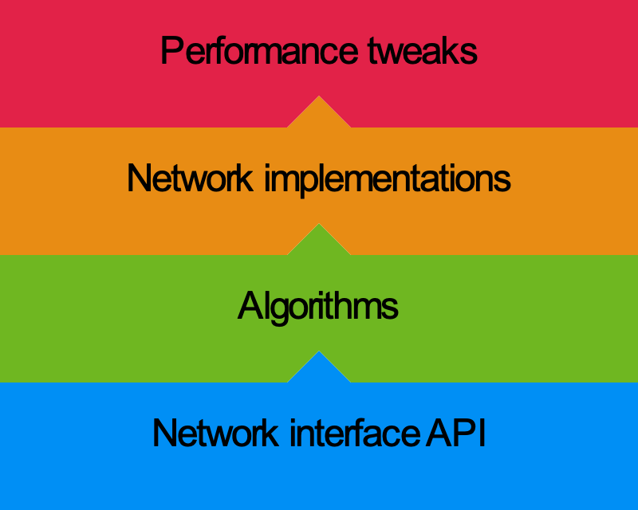
mockturtle: Philosophy (1)
Network interface API is a collection of agreed names (no abstract base class)
Algorithms are implemented using a subset of the naming conventions
Network types can be implement an arbitrary subset of the interface
Algorithms may use static compile-time checks for dedicated performance tweaks

Slide 47
mockturtle: Philosophy (2)
Example: Boolean rewriting
AIG
AIG Rw.
Improv.
AIG
MIG
MIG Rw.
Improv.
MIG
…
Redundant, manual work
Almost the same implementation

Slide 48
mockturtle: Philosophy (2)
Example: Boolean rewriting
Each logic representation is implemented only once
AIG
AIG Rw.
Improv.
AIG
AIG
MIG
…
MIG
MIG Rw.
Improv.
MIG
Ntk.
Rw.<T>
Improv.
Ntk.
Each optimization algorithm is implemented only once
…
Redundant, manual work
Almost the same implementation
Decoupling of algorithm and data-structures
Parametrized implementation of algorithms

Slide 49
mockturtle: Generic algorithms
template<typename Ntk>
class algorithm
{
public:
algorithm( Ntk const& ntk )
: ntk_( ntk )
{}
void operator() const {
ntk_.foreach_node( []( const auto& node, auto index ){
std::cout << index << ‘:’ << node << std::endl;
}); }
private:
Ntk const& ntk_; };

Slide 50
mockturtle: Generic algorithms
template<typename Ntk>
class algorithm
{
public:
algorithm( Ntk const& ntk )
: ntk_( ntk )
{}
void operator() const {
ntk_.foreach_node( []( const auto& node, auto index ){
std::cout << index << ‘:’ << node << std::endl;
}); }
private:
Ntk const& ntk_; };
Generic network type as template parameter
Algorithm invokes methods of the network type

Slide 51
mockturtle: Generic algorithms
template<typename Ntk>
class algorithm
{
public:
algorithm( Ntk const& ntk )
: ntk_( ntk )
{}
void operator() const {
ntk_.foreach_node( []( const auto& node, auto index ){
std::cout << index << ‘:’ << node << std::endl;
}); }
private:
Ntk const& ntk_; };
/* does aig_network implement all methods invoked by algorithm? */
aig_network aig;
algorithm<aig_network> aig_algorithm( aig );
/* does mig_network implement all methods invoked by algorithm? */
mig_network mig;
algorithm<mig_network> mig_algorithm( mig );
Static checking at compile-time ensures that network type and algorithm are compatible

Slide 52
mockturtle: Static checking
template<typename Ntk>
class algorithm
{
public:
algorithm( Ntk const& ntk )
: ntk_( ntk )
{}
void operator() const {
ntk_.foreach_node( []( const auto& node, auto index ){
std::cout << index << ‘:’ << node << std::endl;
}); }
private:
Ntk const& ntk_; };
#include <mockturtle/traits.hpp>
template<typename Ntk>
void run_algorithm( Ntk const& ntk ) {
static_check( is_network_type_v<Ntk>, “Ntk is not a network type” );
static_check( has_foreach_node_v<Ntk>, “Ntk does not implement the foreach_node method” );
algorithm<Ntk>( ntk )(); }
Readable error messages using network traits

Slide 53
mockturtle.readthedocs.io

Slide 54
mockturtle: Views (1)
Views can add, remove, or change functionality
Views behave like networks
Examples:
topo_view: guarantees topological order in foreach_node
depth_view: generically implements level and depth
mapping_view: adds mapping interface
cut_view: network view on a single rooted cut
mffc_view: network view on a (M)FFC
immutable_view: removes all methods that permit structural changes
fanout_view: generically computes foreach_fanout
window_view: network view on a window

Slide 55
mockturtle: Views (2)
/* create network somehow; aig may not be in topological order */
aig_network aig = ...;
/* create a topological view on the network */
topo_view aig_topo{aig};
/* call algorithm that requires topological order */
cut_enumeration( aig_topo );

Slide 56
mockturtle: Views (2)
/* create network somehow; aig may not be in topological order */
aig_network aig = ...;
/* create a topological view on the network */
topo_view aig_topo{aig};
/* call algorithm that requires topological order */
cut_enumeration( aig_topo );
Create a vector of nodes and inserts them in topological order: std::vector<Ntk::node> topo_order;
Reimplement foreach_node using topo_order
If aig changes topo_order needs to be updated

Slide 57
mockturtle: Highlights
Current data structures: AIGs, MIGs, XAGs, XMGs, k-LUT networks
Combinational and sequential interface methods
Network views
Network event API
Algorithms:
Cut enumeration
LUT mapping
Node resynthesis
Cut rewriting
Refactoring
Resubstitution
Majority-based algebraic depth rewriting
…

Slide 58
Implementation
Generic resynthesis flow
Logic representations: AIG, MIG, XAG (XMG)
Optimization algorithms: rewriting, resubstitution, refactoring, balancing
Non-depth-preserving area optimization (ABC’s compress2rs)
Evaluated with EPFL combinational benchmarks suite
Overall, we achieve similar results with all three representations (30.04% / 27.78% / 31.39%).

Slide 59
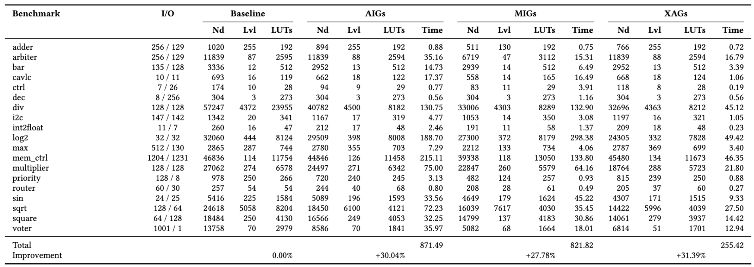
Experimental results

Slide 60
Summary & Conclusion
Logic network library: mockturtle
Generic & scalable logic optimizations
Resynthesis flow for area optimization (ABC’s compress2rs)
Future directions:
Dynamically switching between logic representations
Portfolio logic synthesis methods
Specialized design flows for MIGs, XAGs, XMGs, etc.
Our work enables to prototype and experiment with generic optimization scripts.

Slide 61
Boolean rewriting using Exact synthesis
Objective: Logic synthesis deals with finding a logic circuits of a Boolean function wrt. a cost function (number of gates, depth of the circuit)
Challenge: efficiency & scalability
Our solution: cut rewriting
Simple data structure: DAG-awareness
Peephole optimization: cut enumeration
No database: on-the-fly computation using Exact Synthesis

Slide 62
Boolean rewriting in a nutshell
Input: Boolean network
Result: Optimized network
Partition the network
Yields a set of subntks.
Select an optimal subnetwork from DB
Rewrite if replacement leads to gain (e.g., fewer nodes)
$$x_{1}$$
$$y_{1}$$
$$x_{2}$$
$$y_{2}$$
$$y_{m}$$
$$x_{n}$$
DB

Slide 63
Boolean rewriting in a nutshell
Input: Boolean network
Result: Optimized network
Partition the network
Yields a set of subntks.
Select an optimal subnetwork from DB
Rewrite if replacement leads to gain (e.g., fewer nodes)
$$x_{1}$$
$$y_{1}$$
$$x_{2}$$
$$y_{2}$$
$$y_{m}$$
$$x_{n}$$
DB

Slide 64
Contribution: cut rewriting
High-effort DAG-aware rewriting
Generalized for $k$-LUT networks
Cut enumeration
Effective partitioning
Exact synthesis (no database)
Replacements computed on the fly

Slide 65
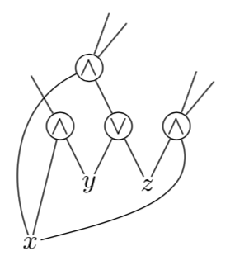
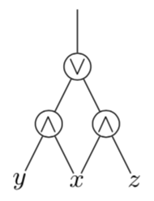
DAG-aware rewriting
7:
4:
5:
6:
2:
3:
1:
Initial network
Replacement candidate

Slide 66
DAG-aware rewriting
7:2
4:1
5:1
6:2
2:2
3:2
1:3
Initial network
Replacement candidate
Initialize each node with its fanout size

Slide 67
DAG-aware rewriting
7:2
4:1
5:0
6:2
2:1
3:1
1:2
Replacement candidate
Initialize each node with its fanout size
Deref. original cut DerefNode(7,{1,2,3})

Slide 68
DAG-aware rewriting
7:2
4:1
5:0
6:2
2:1
3:1
1:2
Initial network
Replacement candidate
Initialize each node with its fanout size
Deref. original cut DerefNode(7,{1,2,3})
2 DELETE

Slide 69
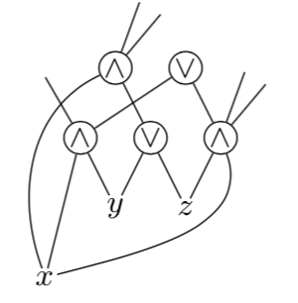
DAG-aware rewriting
7:2
8:0
4:1
5:0
6:2
2:1
3:1
1:2
Replacement candidate
Initialize each node with its fanout size
Deref. original cut DerefNode(7,{1,2,3})
Insert replacement candidate
2 DELETE

Slide 70
DAG-aware rewriting
7:2
8:0
4:2
5:0
6:3
2:1
3:1
1:2
Replacement candidate
Initialize each node with its fanout size
Deref. original cut DerefNode(7,{1,2,3})
Insert replacement candidate
Ref. replacement cut RefNode(8,{1,2,3})
2 DELETE

Slide 71
DAG-aware rewriting
7:2
8:0
4:2
5:0
6:3
2:1
3:1
1:2
Replacement candidate
Initialize each node with its fanout size
Deref. original cut DerefNode(7,{1,2,3})
Insert replacement candidate
Ref. replacement cut RefNode(8,{1,2,3})
2 DELETE
1 INSERT

Slide 72
DAG-aware rewriting
7:2
8:0
4:2
5:0
6:3
2:1
3:1
1:2
Replacement candidate
Initialize each node with its fanout size
Deref. original cut DerefNode(7,{1,2,3})
Insert replacement candidate
Ref. replacement cut RefNode(8,{1,2,3})
2 DELETE
Gain = 1
1 INSERT

Slide 73
DAG-aware rewriting
7:2
8:0
4:1
5:1
6:2
2:2
3:2
1:3
Replacement candidate
Initialize each node with its fanout size
Deref. original cut DerefNode(7,{1,2,3})
Insert replacement candidate
Ref. replacement cut RefNode(8,{1,2,3})
Deref. replacement cut DerefNode(8,{1,2,3})
Ref. original cut RefNode(7,{1,2,3})
2 DELETE
Gain = 1
1 INSERT
Reset reference counters

Slide 74
Cut enumeration
Since number of fan-in may vary for each child, loop is implemented as mixed-radix enumeration
If network is homogeneous (i.e., each gate has same number of fan-in), then nested for-loops are used
The type of network can be checked using a static condition at compile time, therefore avoiding run-time overhead

Slide 75
Exact Synthesis
Does there exist a Boolean network $N$ which implements $f:𝔹^{n}→𝔹^{m}$ using $C\left(N\right)≤r$?
Boolean network
Boolean function $f$
Exact Synthesis Oracle
Upper cost bound $r$
No network exists
(Resource limit)
?
Out of resources

Slide 76
Exact Synthesis
Does there exist a Boolean network $N$ which implements $f:𝔹^{n}→𝔹^{m}$ using $C\left(N\right)≤r$?

Slide 77
Cut rewriting
Cut enumeration

Slide 78
Cut rewriting
Cut enumeration
Apply exact synthesis to each cut for finding a minimum size replacement

Slide 79
Cut rewriting
Conflict graph
Weighted node: poss. replacement (poss. gain)
Edge: replacements are in conflict

Slide 80
Cut rewriting
Conflict graph
Weighted node: poss. replacement (poss. gain)
Edge: replacements are in conflict
5
4
1
5
4
2
3

Slide 81
Cut rewriting
Heuristically solve max. weighted independent vertex set problem
Greedy alg.: GWMIN
Approx. guarantee for finding a solution with weight at least $α(G)/Δ$.
5
4
1
5
4
2
3

Slide 82
Cut rewriting
Heuristically solve max. weighted independent vertex set problem
Greedy alg.: GWMIN
Approx. guarantee for finding a solution with weight at least $α(G)/Δ$.
Weight of exact solution
Degree of G
5
4
1
5
4
2
3

Slide 83
Cut rewriting
Heuristically solve max. weighted independent vertex set problem
Greedy alg.: GWMIN
Approx. guarantee for finding a solution with weight at least $α(G)/Δ$.
5
4
1
5
4
2
4 + 5 + 3 = 12
3

Slide 84
Cut rewriting
Heuristically solve max. weighted independent vertex set problem
Merge selected subnetworks from (4) into the network
5
4
1
5
4
2
4 + 5 + 3 = 12
3

Slide 85
Experimental Results
Resynthesis of $k$-LUT networks ($k∈\{3,4\}$)
ISCAS benchmarks & arithmetic EPFL benchmarks
Average size improvement: 5.58% / 4.04%
Max. size improvement: 40.19% / 12.60%
3-LUT networks
4-LUT networks

Slide 86
Conclusion
New algorithm for Boolean networks: cut rewriting
Simple data structure: DAG-awareness
Peephole optimization: cut enumeration
No database: on-the-fly computation using exact synthesis
Experimental results for size improv. after LUT mapping using ISCAS and EPFL combinational benchmarks
Open source implementation
https://github.com/lsils/lstools-showcase

Slide 87
Summary
EPFL logic synthesis libraries:
alice, lorina, kitty, mockturtle, percy
Open source infrastructure for logic synthesis
Integration with Verilog RTL synthesis (Yosys)
Ecosystem for logic synthesis problems
Sustainability through community building

Slide 88
EPFL Logic Synthesis Libraries
Heinz Riener
heinz.riener@epfl.ch
¹EPFL, Lausanne, Switzerland
Logic Synthesis Software School (LSSS), 2019
Lausanne, Switzerland
https://github.com/lsils/lstools-showcase
★ Star and fork us on GitHub!

